Slide 1
Visual Leak Detector
Randy Gong

Slide 2
Outline
Introduction
Set environment for using it
Practice

Slide 3
Introduction
Visual Leak Detector is a free, robust, open-source memory leak detection system for Visual C++.
Provides a complete stack trace for each leaked block, including source file and line number information when available.
Detects most, if not all, types of in-process memory leaks including COM-based leaks, and pure Win32/Win64 heap-based leaks.
Notes:
Visual C++ provides built-in memory leak detection, but its capabilities are minimal at best. This memory leak detector was created as a free alternative to the built-in memory leak detector provided with Visual C++. Here are some of Visual Leak Detector's features, none of which exist in the built-in detector:

Slide 4
Selected modules (DLLs or even the main EXE) can be excluded from leak detection.
Provides complete data dumps (in hex and ASCII) of leaked blocks.
Customizable memory leak report: can be saved to a file or sent to the debugger and can include a variable level of detail.

Slide 5
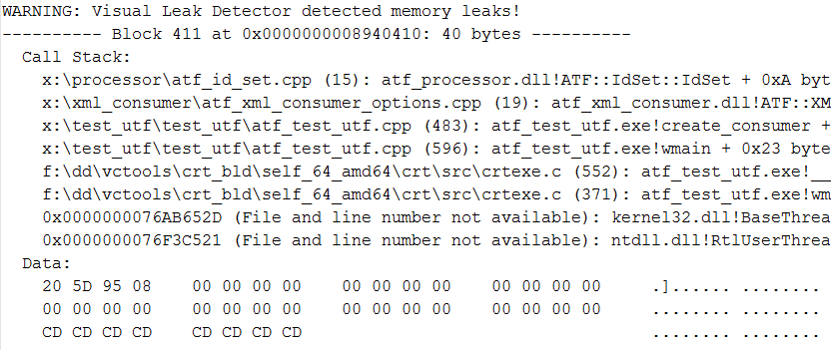
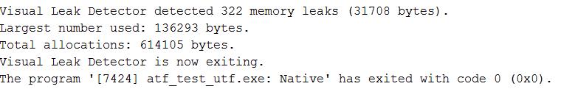

Slide 6
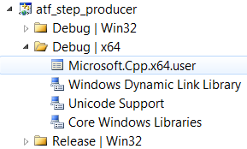
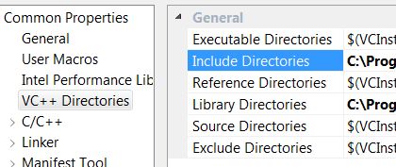
Set environment for using it
Go to View ->Property Manager, select one project’s Microsoft.Cpp.Win64.user. Select VC++ Directories and then add your include path into "Include Directories". Select "Library Directories" and add your path into it.

Slide 7
And remember to close and open the Visual Studio IDE once you have modified the default include and library paths.
In at least one C/C++ source file, include the vld.h header file after stdafx.h (or any other precompiled header).

Slide 8
If your program contains one or more DLLs that you would also like to check for memory leaks, then also include vld.h in at least one source file from each DLL.
Build the debug version of your program.

Slide 9
Reference:
http://vld.codeplex.com/

